Slide 1
CN:CST31209 : Deep Learning and Big Data Intelligence
JING WEN
Spring 2021
Lecture 4:Training Neural Networks I
Notes:
Where to put block multi-vector algorithms?
Percentage of Future Work
Diagram

Slide 2
Where we are now...
Mini-batch SGD
Loop:
Sample a batch of data
Forward prop it through the graph, get loss
Backprop to calculate the gradients
Update the parameters using the gradient

Slide 3
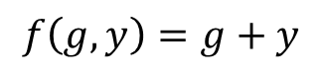
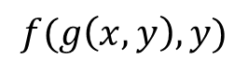
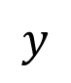
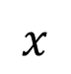
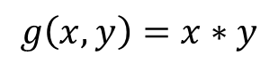
Partial and Total Derivatives
$$g\left(x,y\right)=x∗y$$
$$x$$
*
+
$$f\left(g,y\right)=g+y$$
$$y$$
$$f(g\left(x,y\right),y)$$

Slide 4
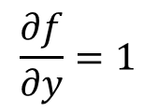
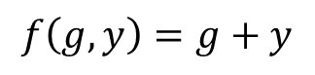
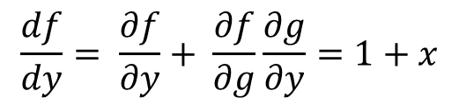
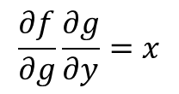
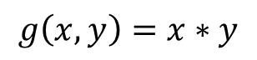
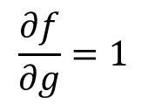
Partial and Total Derivatives
$$g\left(x,y\right)=x∗y$$
$$x$$
$$\frac{∂f}{∂g}=1$$
*
$$\frac{∂f}{∂g}\frac{∂g}{∂y}=x$$
+
$$f\left(g,y\right)=g+y$$
$$y$$
$$\frac{∂f}{∂y}=1$$
$$\frac{df}{dy}= \frac{∂f}{∂y}+ \frac{∂f}{∂g}\frac{∂g}{∂y}=1+x$$
$$f(g\left(x,y\right),y)$$

Slide 5
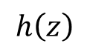
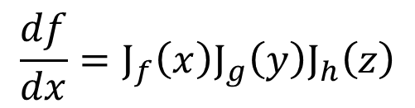
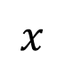
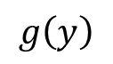
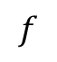
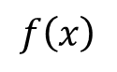
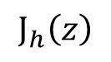
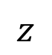
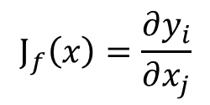
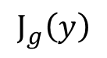
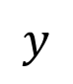
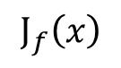
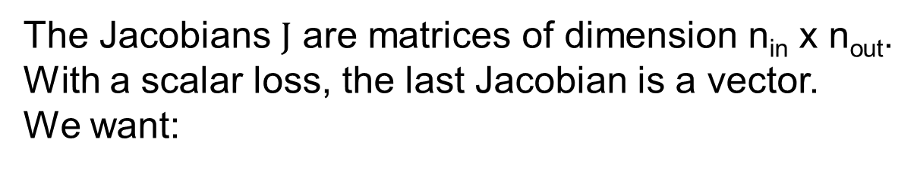
Why Backprop?
$$x$$
$$y$$
$$z$$
:
:
$$f\left(x\right)$$
:
:
$$g\left(y\right)$$
:
:
$$h\left(z\right)$$
$$f$$
$${\text{J}}_{f}\left(x\right)=\frac{∂y_{i}}{∂x_{j}}$$
$${\text{J}}_{f}\left(x\right)$$
$${\text{J}}_{g}\left(y\right)$$
$${\text{J}}_{h}\left(z\right)$$
The Jacobians $\text{J}$ are matrices of dimension n_{in} x n_{out}.
With a scalar loss, the last Jacobian is a vector.
We want:
$$\frac{df}{dx}={\text{J}}_{f}\left(x\right){\text{J}}_{g}\left(y\right){\text{J}}_{h}\left(z\right)$$

Slide 6
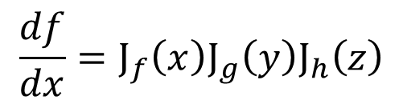
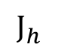
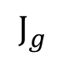
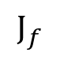
Why Backprop?
We want:
$$\frac{df}{dx}={\text{J}}_{f}\left(x\right){\text{J}}_{g}\left(y\right){\text{J}}_{h}\left(z\right)$$
$${\text{J}}_{f}$$
$${\text{J}}_{g}$$
$${\text{J}}_{h}$$
Two matrix-vector multiplies O(n²)

Slide 7
Forwardprop?
We want:
$$\frac{df}{dx}={\text{J}}_{f}\left(x\right){\text{J}}_{g}\left(y\right){\text{J}}_{h}\left(z\right)$$
$${\text{J}}_{f}$$
$${\text{J}}_{g}$$
$${\text{J}}_{h}$$
First multiply O(n³)

Slide 8
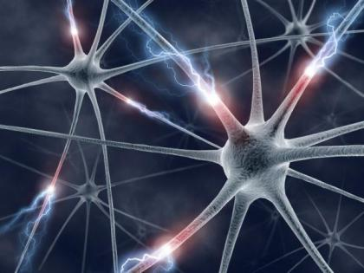
Real Neural Networks

Slide 9
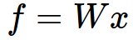
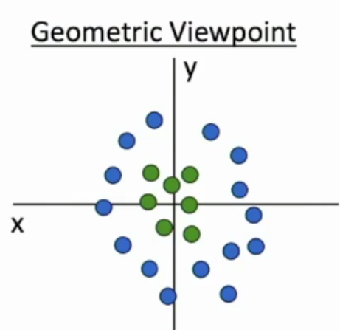
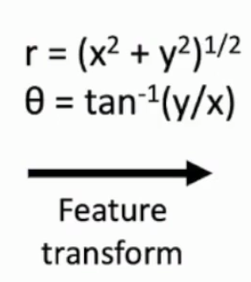
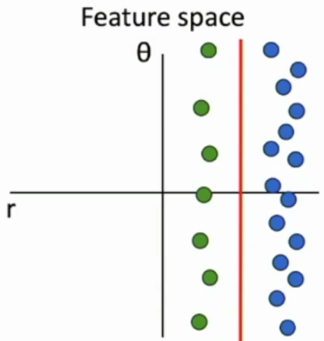
Neural Network: without the brain stuff
(Before) Linear score function:

Slide 10
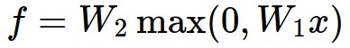
Neural Network: without the brain stuff
(Before) Linear score function:
(Now) 2-layer Neural Network

Slide 11
Neural Network: without the brain stuff
(Before) Linear score function:
(Now) 2-layer Neural Network
x
h
W1
W2
s
3072
100
10

Slide 12
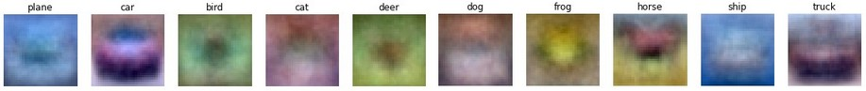
Neural Network: without the brain stuff
(Before) Linear score function:
(Now) 2-layer Neural Network
x
h
W1
W2
s
3072
100
10

Slide 13
Neural Network: without the brain stuff
(Before) Linear score function:
(Now) 2-layer Neural Network
or 3-layer Neural Network

Slide 14
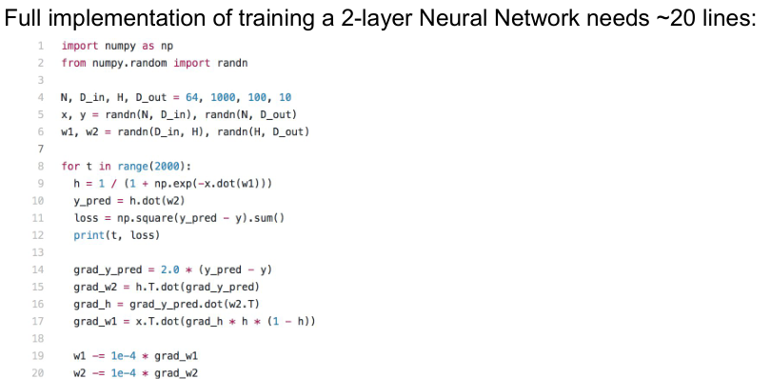

Full implementation of training a 2-layer Neural Network needs ~11 lines:
from @iamtrask, http://iamtrask.github.io/2015/07/12/basic-python-network/

Slide 15
Real Neural Networks:

Slide 16


Slide 17


Slide 18

树突
突触
轴突

Slide 19
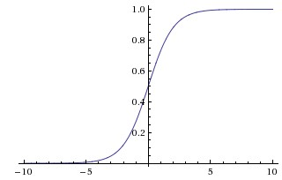
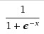
sigmoid activation function

Slide 20
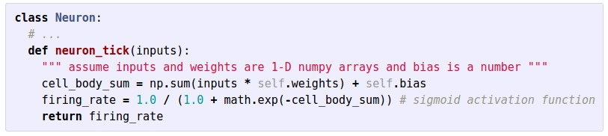

Slide 21
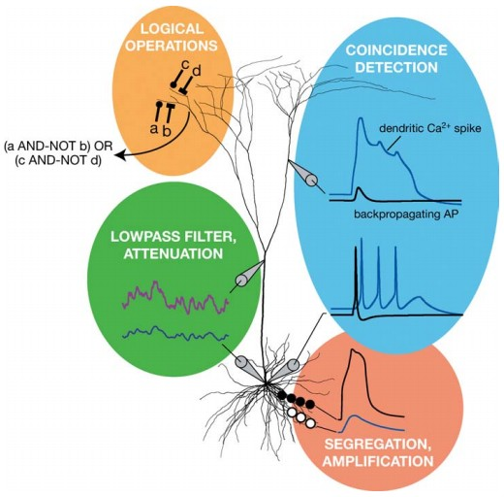
Be very careful with your Brain analogies:
Biological Neurons:
Many different types
Dendrites can perform complex non-linear computations
Synapses are not a single weight but a complex non-linear dynamical system
Rate code may not be adequate
[Dendritic Computation. London and Hausser]

Slide 22
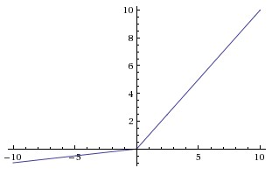

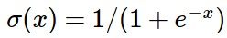
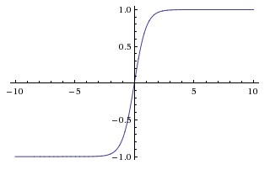
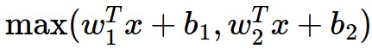
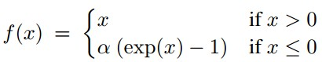
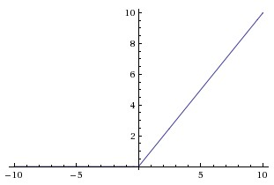
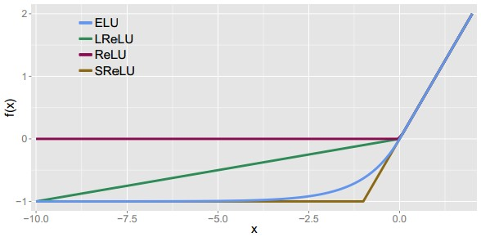
Activation Functions
Sigmoid
Leaky ReLU
max(0.1x, x)
Maxout
tanh tanh(x)
ELU
ReLU max(0,x)

Slide 23

Neural Networks: Architectures
“3-layer Neural Net”, or
“2-hidden-layer Neural Net”
“2-layer Neural Net”, or
“1-hidden-layer Neural Net”
“Fully-connected” layers

Slide 24
Example Feed-forward computation of a Neural Network
We can efficiently evaluate an entire layer of neurons.

Slide 25
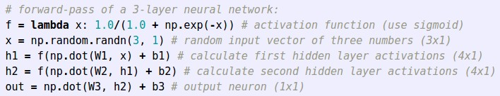
Example Feed-forward computation of a Neural Network

Slide 26

Setting the number of layers and their sizes
more neurons = more capacity

Slide 27
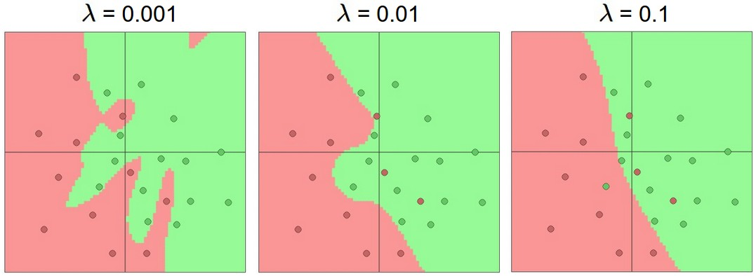
Do not use size of neural network as a regularizer.
Use stronger regularization instead:
(you can play with this demo over at ConvNetJS: http://cs.stanford.edu/people/karpathy/convnetjs/demo/classify2d.html)

Slide 28
Summary
we arrange neurons into fully-connected layers
the abstraction of a layer has the nice property that it allows us to use efficient vectorized code (e.g. matrix multiplies)
neural networks are not really neural
neural networks: bigger = better (but might have to regularize more strongly)

Slide 29
Training Neural Networks
A bit of history...

Slide 30
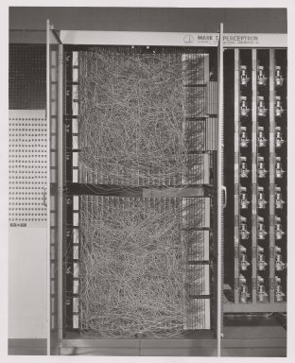

A bit of history
The Mark I Perceptron machine was the first implementation of the perceptron algorithm.
The machine was connected to a camera that used 20×20 cadmium sulfide photocells to produce a 400-pixel image.
recognized
letters of the alphabet
update rule:
Frank Rosenblatt, ~1957: Perceptron

Slide 31



A bit of history
Widrow and Hoff, ~1960: Adaline/Madaline

Slide 32


A bit of history
recognizable math
Rumelhart et al. 1986: First time back-propagation became popular

Slide 33

A bit of history
[Hinton and Salakhutdinov 2006]
Reinvigorated research in Deep Learning

Slide 34



First strong results
Context-Dependent Pre-trained Deep Neural Networks
for Large Vocabulary Speech Recognition
George Dahl, Dong Yu, Li Deng, Alex Acero, 2010
Imagenet classification with deep convolutional
neural networks
Alex Krizhevsky, Ilya Sutskever, Geoffrey E Hinton, 2012

Slide 35
Overview
One time setup
activation functions, preprocessing, weight initialization, regularization, gradient checking
Training dynamics
babysitting the learning process,
parameter updates, hyperparameter optimization
Evaluation
model ensembles

Slide 36
Part I
Activation functions
Preprocessing
Weight initialization,
Batch Normalization(BN)
Babysitting the learning Process
Hyperparameter Optimization

Slide 37
Activation Functions

Slide 38
Activation Functions

Slide 39
Activation Functions
Sigmoid
Leaky ReLU
max(0.1x, x)
Maxout
tanh tanh(x)
ELU
ReLU max(0,x)

Slide 40
Activation Functions
Squashes numbers to range [0,1] – can kill gradients.
Not zero-centered
Not as good for image networks (replaced by RELU)
A key element in LSTM networks – “control signals”
Best for learning “logical” functions – i.e. functions on binary inputs.
Sigmoid

Slide 41

What happen when x=-10?
What happen when x=10?
What happen when x=0?

Slide 42


Slide 43

Consider what happens when the input to a neuron (x)
is always positive:
What can we say about the gradients on w?

Slide 44
Consider what happens when the input to a neuron is always positive...
allowed gradient update directions
zig zag path
allowed gradient update directions
hypothetical optimal w vector
What can we say about the gradients on w?
Always all positive or all negative :(
(this is also why you want zero-mean data!)

Slide 45
Activation Functions
Squashes numbers to range [-1,1]
Zero centered (nice)
Still kills gradients when saturated :(
Also used in LSTMs for bounded, signed values.
Not as good for binary functions
tanh(x)
[LeCun et al., 1991]

Slide 46
Activation Functions
Computes f(x) = max(0,x)
Does not saturate (in +region)
Converges faster than sigmoid/tanh on image data (e.g. 6x)
Not suitable for logical functions
Not for control in recurrent nets
ReLU
(Rectified Linear Unit)
[Krizhevsky et al., 2012]

Slide 47
Activation Functions
Computes f(x) = max(0,x)
Does not saturate (in +region)
Very computationally efficient
Converges much faster than sigmoid/tanh in practice (e.g. 6x)
Not zero-centered output
An annoyance:
hint: what is the gradient when x < 0?
ReLU
(Rectified Linear Unit)

Slide 48




ReLU
gate
x
What happens when x = -10?
What happens when x = 0?
What happens when x = 10?

Slide 49
DATA CLOUD
active ReLU
dead ReLU
will never activate
=> never update

Slide 50


Slide 51


Slide 52
DATA CLOUD
active ReLU
=> people like to initialize ReLU neurons with slightly positive biases (e.g. 0.01)
dead ReLU
will never activate
=> never update

Slide 53

Activation Functions
[Mass et al., 2013]
[He et al., 2015]
Does not saturate
Converges faster than sigmoid/tanh on image data(e.g. 6x)
will not “die”.
Leaky ReLU

Slide 54

Activation Functions
[Mass et al., 2013]
[He et al., 2015]
Does not saturate
Converges faster than sigmoid/tanh on image data (e.g. 6x)
will not “die”.
Parametric Rectifier (PReLU)
Leaky ReLU
backprop into \alpha
(parameter)

Slide 55


Activation Functions
[Clevert et al., 2015]
Exponential Linear Units (ELU)
All benefits of ReLU
Does not die
Closer to zero mean outputs

Slide 56
[Goodfellow et al., 2013]
Maxout “Neuron”
Does not have the basic form of dot product -> nonlinearity
Generalizes ReLU and Leaky ReLU
Linear Regime! Does not saturate! Does not die!
Problem: doubles the number of parameters/neuron :(

Slide 57


Slide 58
TLDR: In practice:
Try everything. Usually:
Use ReLU on early image layers.
Try out Leaky ReLU / Maxout / ELU
Use sigmoids for “logic” functions (click prediction, recommendation).
Tanh – worth a try. Gives signed values that wont explode.

Slide 59
Data Preprocessing

Slide 60



Step 1: Preprocess the data
(Assume X [NxD] is data matrix, each example in a row)

Slide 61

Step 1: Preprocess the data
In practice, you may also see PCA and Whitening of the data
(data has diagonal covariance matrix)
(covariance matrix is the identity matrix)

Slide 62

Step 1: Preprocess the data
Before After

Slide 63
TLDR: In practice for Images: center only
e.g. consider CIFAR-10 example with [32,32,3] images
Subtract the mean image (e.g. AlexNet)
(mean image = [32,32,3] array)
Subtract per-channel mean (e.g. VGGNet)
(mean along each channel = 3 numbers)
Subtract per-channel mean and Divide by per-channel std(e.g. ResNet)
(mean along each channel = 3 numbers)
Not common to normalize variance, to do PCA or whitening

Slide 64

Weight Initialization
Notes:
神经网络是复杂的非线性模型
初始点的选取有时能决定模型是否收敛

Slide 65
Weight Initialization
Q: what happens when W=0 init is used?
Q: what happens when W=a(a<>0) init is used?
Notes:
多层神经网络不能将权重初始化为同一个数。

Slide 66
Weight Initialization
First idea: Small random numbers
(gaussian with zero mean and 1e-2 standard deviation)

Slide 67
Weight Initialization
First idea: Small random numbers
(gaussian with zero mean and 1e-2 standard deviation)
Works ~okay for small networks, but can lead to non-homogeneous distributions of activations across the layers of a network.

Slide 68

Activation Statistics
E.g. 10-layer net with 500 neurons on each layer, using tanh non-linearities, and initializing as described in last slide.

Slide 69


Slide 70
All activations become zero!
Q: think about the backward pass. What do the gradients look like?
Hint: think about backward pass for a W*X gate.

Slide 71

*1.0 instead of *0.01
Almost all neurons completely saturated, either -1 and 1. Gradients will be all zero.

Slide 72




“Xavier initialization”
[Glorot et al., 2010]
Reasonable initialization.
(Mathematical derivation assumes linear activations)
=1

Slide 73

but when using the ReLU nonlinearity it breaks.

Slide 74

He et al., 2015
(note additional /2)

Slide 75

He et al., 2015
(note additional /2)

Slide 76
Proper initialization is an active area of research…
Understanding the difficulty of training deep feedforward neural networks
by Glorot and Bengio, 2010
Exact solutions to the nonlinear dynamics of learning in deep linear neural networks by Saxe et al, 2013
Random walk initialization for training very deep feedforward networks by Sussillo and Abbott, 2014
Delving deep into rectifiers: Surpassing human-level performance on ImageNet classification by He et al., 2015
Data-dependent Initializations of Convolutional Neural Networks by Krähenbühl et al., 2015
All you need is a good init, Mishkin and Matas, 2015
…

Slide 77

Batch Normalization
[Ioffe and Szegedy, 2015]
“you want unit gaussian activations? just make them so.”
consider a batch of activations at some layer. To make each dimension unit gaussian, apply:
this is a vanilla differentiable function...

Slide 78
Batch Normalization
[Ioffe and Szegedy, 2015]
“you want unit gaussian activations?
just make them so.”
1. compute the empirical mean and variance independently for each dimension.
X
N
2. Normalize
D

Slide 79
Batch Normalization
[Ioffe and Szegedy, 2015]
FC
Usually inserted after Fully Connected / (or Convolutional, as we’ll see soon) layers, and before nonlinearity.
BN
tanh
FC
Problem: do we necessarily want a unit gaussian input to a tanh layer?
BN
tanh
...

Slide 80



Batch Normalization
[Ioffe and Szegedy, 2015]
Normalize:
Note, the network can learn:
And then allow the network to squash
the range if it wants to:
to recover the identity mapping.

Slide 81

Batch Normalization
[Ioffe and Szegedy, 2015]
Improves gradient flow through the network
Allows higher learning rates
Reduces the strong dependence on initialization
Acts as a form of regularization in a funny way, and slightly reduces the need for dropout, maybe

Slide 82
Batch Normalization
[Ioffe and Szegedy, 2015]
Note: at test time BatchNorm layer functions differently:
The mean/std are not computed based on the batch. Instead, a single fixed empirical mean of activations during training is used.
(e.g. can be estimated during training with running averages)

Slide 83
Babysitting the Learning Process

Slide 84
Step 1: Preprocess the data
(Assume X [NxD] is data matrix, each example in a row)

Slide 85
Step 2: Choose the architecture:
say we start with one hidden layer of 50 neurons:
50 hidden neurons
10 output neurons, one per class
output layer
CIFAR-10 images, 3072 numbers
input layer
hidden layer

Slide 86


3.Double check that the loss is reasonable:
disable regularization
loss ~2.3.
“correct “ for
10 classes
returns the loss and the gradient for all parameters
Notes:
检查前向传播

Slide 87

Double check that the loss is reasonable:
crank up regularization
loss went up, good. (sanity check)

Slide 88

4.Lets try to train now…
Tip: Make sure that you can overfit very small portion of the training data
The above code:
take the first 20 examples from CIFAR-10
turn off regularization (reg = 0.0)
use simple vanilla ‘sgd’
Notes:
完整性检查

Slide 89

Lets try to train now…
Tip: Make sure that you can overfit very small portion of the training data
Very small loss,
train accuracy 1.00,
nice!
Notes:
达到过饱和，则反向传播，学习率，权重值等更新正常

Slide 90

Lets try to train now…
5.
I like to start with small regularization and find learning rate that makes the loss go down.
Notes:
真正训练

Slide 91
Lets try to train now…
I like to start with small regularization and find learning rate that makes the loss go down.
Loss barely changing

Slide 92
Lets try to train now…
I like to start with small regularization and find learning rate that makes the loss go down.
loss not going down:
learning rate too low
Loss barely changing: Learning rate is probably too low

Slide 93
Lets try to train now…
I like to start with small regularization and find learning rate that makes the loss go down.
loss not going down:
learning rate too low
Loss barely changing: Learning rate is probably too low
Notice train/val accuracy goes to 20% though, what’s up with that? (remember this is softmax)

Slide 94

Lets try to train now…
I like to start with small regularization and find learning rate that makes the loss go down.
loss not going down:
learning rate too low
Okay now lets try learning rate 1e6. What could possibly go wrong?

Slide 95
Lets try to train now…
I like to start with small regularization and find learning rate that makes the loss go down.
loss not going down:
learning rate too low
loss exploding:
learning rate too high
cost: NaN almost always means high learning rate...

Slide 96

Lets try to train now…
I like to start with small regularization and find learning rate that makes the loss go down.
loss not going down:
learning rate too low
loss exploding:
learning rate too high
3e-3 is still too high. Cost explodes….
=> Rough range for learning rate we should be cross-validating is somewhere [1e-3 … 1e-5]

Slide 97
Hyperparameter Optimization

Slide 98

Learning rates

Slide 99
Cross-validation strategy
I like to do coarse -> fine cross-validation in stages
First stage: only a few epochs to get rough idea of what params work
Second stage: longer running time, finer search
… (repeat as necessary)
Tip for detecting explosions in the solver:
If the cost is ever > 3 * original cost, break out early

Slide 100


For example: run coarse search for 5 epochs
note it’s best to optimize in log space!
nice

Slide 101


Now run finer search...
adjust range
53% - relatively good for a 2-layer neural net with 50 hidden neurons.

Slide 102
Now run finer search...
adjust range
53% - relatively good for a 2-layer neural net with 50 hidden neurons.
But this best cross-validation result is worrying. Why?

Slide 103

Random Search vs. Grid Search
Random Search for Hyper-Parameter Optimization
Bergstra and Bengio, 2012

Slide 104

Hyperparameters to play with:
network architecture
learning rate, its decay schedule, update type
regularization (L2/Dropout strength)
neural networks practitioner
music = loss function

Slide 105

A cross-validation “command center”

Slide 106


Monitor and visualize the loss curve

Slide 107
Loss
time

Slide 108
Loss
Bad initialization
a prime suspect
time

Slide 109



lossfunctions.tumblr.com
Loss function specimen

Slide 110


lossfunctions.tumblr.com

Slide 111


lossfunctions.tumblr.com

Slide 112

Monitor and visualize the accuracy:
big gap = overfitting
=> increase regularization strength?
no gap
=> increase model capacity?
Notes:
欠拟合在训练集和验证集上都 很差
过拟合在训练集上好，在验证集上差

Slide 113

Notes:
模型容量与参数大小关系

Slide 114


Slide 115

Track the ratio of weight updates / weight magnitudes:
ratio between the values and updates: ~ 0.0002 / 0.02 = 0.01 (about okay)
want this to be somewhere around 0.001 or so

Slide 116

Notes:
没有训练好造成

Slide 117


Slide 118


Slide 119
Summary
We looked in detail at:
Activation Functions (use ReLU for images)
Data Preprocessing (images: subtract mean)
Weight Initialization (use Xavier init)
Batch Normalization (use)
Babysitting the Learning process
Hyperparameter Optimization
(random sample hyperparams, in log space when appropriate)
TLDRs

Slide 120
总结
训练一个神经网络需要：
利用小批量数据对实现进行梯度检查，还要注意各种错误。
进行合理性检查，确认初始损失值是合理的，在小数据集上能得到100%的准确率。
在训练时，跟踪损失函数值，训练集和验证集准确率，如果愿意，还可以跟踪更新的参数量相对于总参数量的比例（一般在1e-3左右），然后如果是对于卷积神经网络，可以将第一层的权重可视化。
推荐的两个更新方法是SGD+Nesterov动量方法，或者Adam方法。
随着训练进行学习率衰减。比如，在固定多少个周期后让学习率减半，或者当验证集准确率下降的时候。
使用随机搜索（不要用网格搜索）来搜索最优的超参数。分阶段从粗（比较宽的超参数范围训练1-5个周期）到细（窄范围训练很多个周期）地来搜索。

Slide 121
TODO
Look at:
Parameter update schemes
Learning rate schedules
Gradient Checking
Regularization (Dropout etc)
Evaluation (Ensembles etc)

